Slide 1


Project on health management system
GURU NANAK INSTITUTE OF TECHNOLOGY
MASTER OF COMPUTER APPLICATION
By:
Ashutosh Kumar Yadav 504121011006
Mujahid Ali Ansari 504121011025
Shahil Kumar Chourasia 504121011045
Sirsha Majumder 504121021050
Sonu Routh 504121011051
Under the guidance of:
DOLA SAHA

Slide 2
CONTENT
INDIVIDUAL STUDENT NAME FOLLOWED BY MENTOR NAME.
OBJECTIVE OF THE STUDY
SOFTWARE USE
PROGRAMMING LANGUAGE
APPLICATIONS
INTRODUCTION
FLOW CHART
ADVANTAGES
DISADVANTAGES
COMPONENTS REQUIRED
FUTURE DEVLOPMENTS
INDIVIDUAL CONTRIBUTION OF THE PROJECT

Slide 3
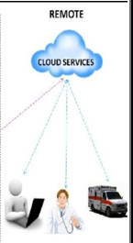
INTRODUCTION
Health is the most important part of any human’s life. By ‘health’, we mean both our physical and mental health. Without a good health, it is useless to cherish any treasure of life.
The project deal with monitoring of the patient parameters
This project introduces a Cloud Based Health Tracking System that can track the records of our daily Health measures like our Fitness Plans and Diet Plans 24x7 suggested by our Nutritionist or Dietician. This application consists of several the parts based on - Python and AWS Cloud
Data storing part is done through AWS Cloud, and Python has been used as a base language.

Slide 4
OBJECTIVE
To provide reliable, latest and useful health information to all levels of health officers and administrators.
To amend health policies and working system on the basis of feedback, received from health information system.
To provide information about periodically and time bound programs and for mid term evaluation.
To contribute towards achievement of objectives of health policies and programs. To increase efficiency and quality in health management.

Slide 5
APPLICATIONS
Most demanding in medical areas.
Maintain the medical records of the patient
Maintain the contact details of the patient
Easy to maintain Our Daily Health Routine.

Slide 6

SOFTWARE USE
AWS Cloud :
Amazon Web Services. Amazon Web Services (AWS) is a secure cloud services platform, offering compute power, database storage, content delivery and other functionality to help businesses scale and grow.

Slide 7

PROGRAMMING LANGUAGE
Python :
Python is an interpreted language. It is a high-level programming language, it abstracts many sophisticated details from the programming code.

Slide 8
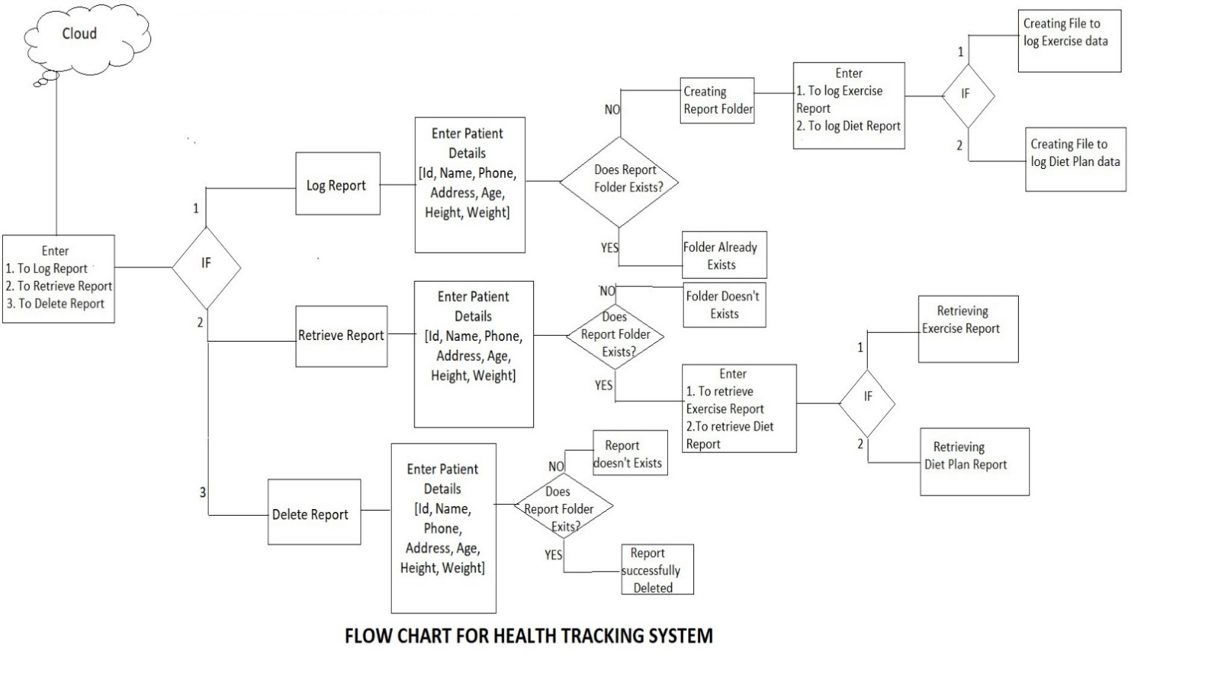
FLOW CHART

Slide 9
ADVANTAGES
EASY TO USE AND REDUCE PAPER WORK.
COST EFFECTIVE
TO MANAGE PATIENT MENU.
BACKUP & RESTORE.

Slide 10
DISADVANTAGES
INTERNET CONNECTIVITY
LIMITED CONTROL
DOWNTIME

Slide 11



COMPONENTS REQUIRED
SOFTWARE
VS CODE
AWS
CODING LANGUAGE
PYTHON

Slide 12
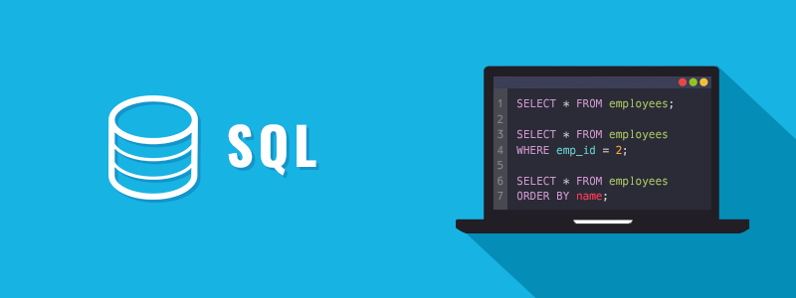
FUTURE DEVELOPMENT
ADD HEALTH FACTORS USING MACHINE LEARNING.
WEB DESIGN FOR HEALTH TRACKING SYSTEM
DATABASE MANAGEMENT SYSTEM.

Slide 13
INDIVIDUAL CONTRIBUTION TO THE PROJECT
NAME OF THE PROJECT MEMBER | CONTRIBUTION
MUJAHID ALI ANSARI | AWS CLOUD SERVICE
ASHUTOSH KUMAR YADAV | PRESENTATION
SHAHIL KUMAR CHOURASIA | PYTHON CODING
SONU ROUTH | PYTHON CODING
SIRSHA MAJUMDER | PROJECT REPORT

Slide 14
THANK YOU

